Slide 1
EFFECTIVE MESSAGE PASSING ON HADOOP
Special Topic By,
Surabhi R (1PI10IS109 )
Shreya Chippagiri (1PI10IS134)

Slide 2
Problem Statement
Effective Message Passing on Hadoop.
Hadoop is a popular open-source cloud computing platform that provides a software programming framework called MapReduce and the distributed filesystem, HDFS, which are useful for analyzing a large data set.

Slide 3
Message passing amongst the slave nodes and between the master and the slave nodes can lead to tremendous network traffic,bottlenecks and latencies if not optimised.
Therefore, in this project ,we attempt to optimise the network routes using a Software Defined Network(SDN) approach to obtain scalability for a large data set by harnessing MapReduce and HDFS.

Slide 4
Hadoop Map Reduce Overview
Hadoop MapReduce: A parallel programming paradigm for implementing data computation.
Hadoop Distributed File System is a Network file system.
The HDFS consists of :
NameNode - Single Management node that maintains the metadata
DataNode - Contain Data in large block sizes of 64 MB.
JobTracker is responsible for delegating the specific map and reduce task for clusters.
Keeps track of time.
TaskTrackers are computation nodes.

Slide 5
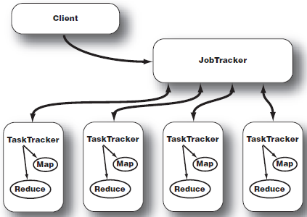
JobTracker & TaskTracker

Slide 6
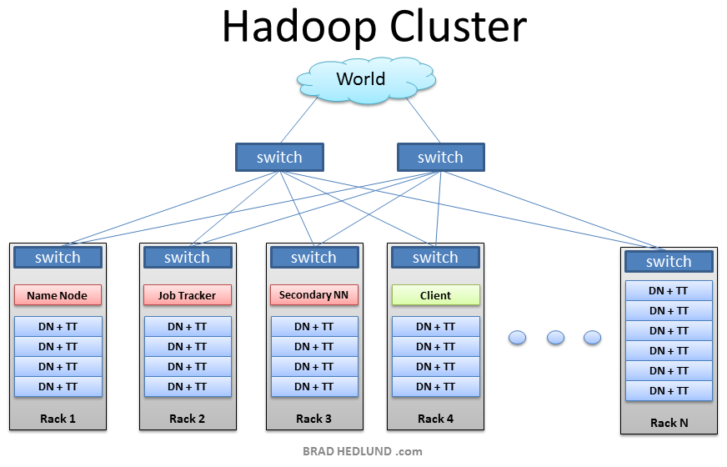

Slide 7
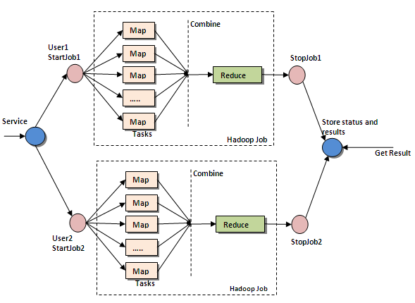
MapReduce Job

Slide 8
Network Bottlenecks and Latency
Network Latency
Why its caused:
At times of failure - Jobs are reassigned.
If jobs are busy, can affect the time complexity.
Possible Solution:
Implement Buffers.
Effective job scheduling.
Priority queues.
Distance between nodes
Possible Solution:
SDN based network routing.
Implement routing algorithms.

Slide 9
Bottlenecks Continued…
Rack-Awareness
Allows you to manually define the rack numbers to which the slave belongs to. Communication between the NameNode and the DataNode is essential.
Why do we need it?
Data loss prevention
Network Performance - Scalability.
Disadvantages:
1. Manual labour.
Solution:
Use an OpenFlow network where the Name Node could query the OpenFlow Controller about the Node’s topology.

Slide 10
Openstack-Cloud Software
OpenStack is an open source cloud computing project aimed at providing an Infrastructure-as-a-Service, first version released in October 2010.
Openstack has 9 components which are namely Nova, Swift, Cinder, Neutron, Horizon, Keystone, RabbitMQ,Glance, Ceilometer and Heat.

Slide 11
This project primarily deals with Neutron which is the SDN(Openflow) component of the Openstack and RabbitMQ which is the messaging part.
Neutron is an OpenStack project to provide "networking as a service" between interface devices (e.g., vNICs) managed by other Openstack services (e.g., nova).
The Open vSwitch plug-in is one of the most popular core plug-ins. Open vSwitch configurations consists of bridges and ports.
RabbitMQ- RabbitMQ is the default open source message broker software (sometimes called message-oriented middleware) that implements the Advanced Message Queuing Protocol (AMQP). The RabbitMQ server is written in the Erlang programming language and is built on the Open Telecom Platform framework for clustering and failover.

Slide 12
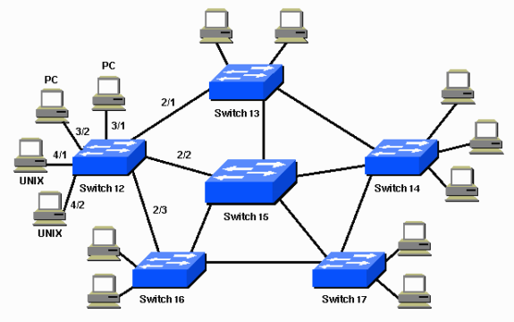
Routing Algorithms
Link State Algorithm
Distance Vector Algorithm
Spanning Tree Protocol

Slide 13
Distance Vector Algorithm
Distance-vector protocols are based on calculating the the next hop address and the cost to reach a certain node.
The least cost route between any two nodes is the route with minimum distance.
Each node maintains a vector table of minimum distance to every node.
The cost of reaching a destination is calculated using various route metrics like
RIP uses the hop count of the destination
IGRP takes into account other information such as node delay and available bandwidth.

Slide 14
Link State Algorithm
Every node constructs a map of the connectivity to the network, in the form of a graph, showing which nodes are connected to which other nodes.
Each node then independently calculates the next best logical path from it to every possible destination in the network.
The collection of best paths will then form the node's routing table.
Examples of link-state routing protocols include open shortest path first (OSPF) and intermediate system to intermediate system (IS-IS).

Slide 15
Spanning Tree Protocol
Using the spanning tree algorithm, STP provides path redundancy while preventing undesirable loops in a network that are created by multiple active paths between stations.
Loops occur when there are alternate routes between hosts.
To establish path redundancy, STP creates a tree that spans all of the switches in an extended network, forcing redundant paths into a standby, or blocked, state.

Slide 16
Approach
Install Openstack using devstack and Hadoop.
Get the Hadoop jobs running.
Dig into the Neutron and RabbitMQ components of openstack.
Implement suitable routing algorithms for the hadoop nodes in the cluster.

Slide 17
Bibliography
Openstack-www.openstack.org
Devstack-www.devstack.org
Hadoop-hadoop.apache.org
ask.openstack.org
Research Papers:
Overcoming Networking Bottlenecks of Hadoop MapReduce Jobs
William Clay Moody - wcm@clemson.edu December 4, 2012 http://www.chinacloud.cn/upload/2012-12/12122409238948.pdf
Performance Issues of Heterogeneous Hadoop Clusters in Cloud Computing
http://arxiv.org/abs/1207.0894
Meta-data driven data ingestion using MapReduce framework
https://www.google.co.in/patents/EP2653968A2?cl=en&dq=hadoop+mapreduce&hl=en&sa=X&ei=o2WGUpygFIToiAfHi4CIAw&ved=0CFMQ6AEwAw
AND A FEW MORE…

Slide 18
Thank you!

